Slide 1

Chapter:1
Diode Theory
03107101 : BASIC ELECTRONICS
Compiled by
DURVESH ASLAM
Assistant Professor
Faculty of Engineering and Technology
Parul University

Slide 2
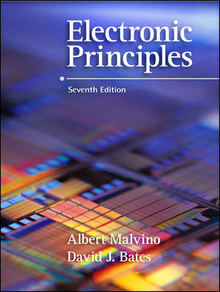
Diode Theory
Chapter
3

Slide 3
Topics Covered in Chapter 3
Basic ideas
The ideal diode
The second approximation
The third approximation
Troubleshooting
Up-down circuit analysis

Slide 4
Topics Covered in Chapter 3
(Continued)
Reading a data sheet
How to calculate bulk resistance
DC Resistance of a diode
Load lines
Surface-mount diodes

Slide 5
Diode
A nonlinear device
The graph of current vs. voltage is not a straight line
The diode voltage must exceed the barrier voltage to conduct

Slide 6
The diode symbol looks like an arrow
that points from the p side to the n side.
Anode
R
p
V_{S}
=
n
Cathode
The arrow points in the direction of conventional
current flow. This diode is forward biased by V_{S}.

Slide 7
Linearity
The volt-ampere characteristic curve for a resistor is a straight line (linear).
A diode has a non-linear characteristic curve.
The barrier potential produces a knee in the diode curve.
The knee voltage is about 0.7 volts for a silicon diode.

Slide 8
200
175
150
125
100
Forward current in mA
75
50
25
knee
0
0
0.5
1.0
1.5
Forward bias in volts
Silicon diode volt-ampere characteristic curve

Slide 9
breakdown
Reverse bias in Volts
600
400
200
0
20
40
60
Reverse
current
in mA
80
100
120
140
Silicon diode reverse bias characteristic curve

Slide 10
Bulk resistance
The ohmic resistance of the p and n material is called the bulk resistance.
The bulk resistance is often less than 1 Ω.
With forward bias, diode current increases rapidly beyond the knee voltage.
Small increases in voltage cause large increases in current.

Slide 11
Diode ratings
Specified on manufacturers’ data sheets
The maximum reverse bias rating must not be exceeded.
The maximum forward current rating must not be exceeded.
The power rating of a diode is determined by its maximum current rating and the forward voltage drop at that current flow.

Slide 12
Diode first approximation
This represents the diode as being ideal.
The first approximation ignores leakage current, barrier potential and bulk resistance.
When an ideal diode is forward biased, the model is a closed switch.
When an ideal diode is reverse biased, the model is an open switch.

Slide 13
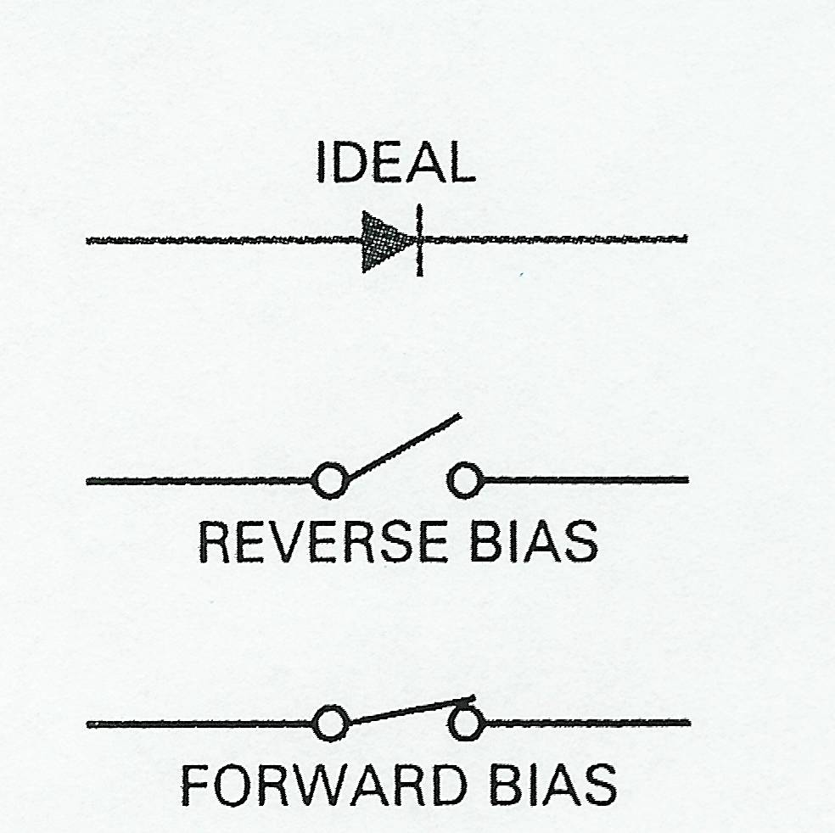
First (ideal) approximation

Slide 14
Diode second approximation
This model assumes that no diode current flows until the forward bias across the diode reaches 0.7 volts.
This model ignores the exact shape of the knee.
This model ignores the diode’s bulk resistance.

Slide 15
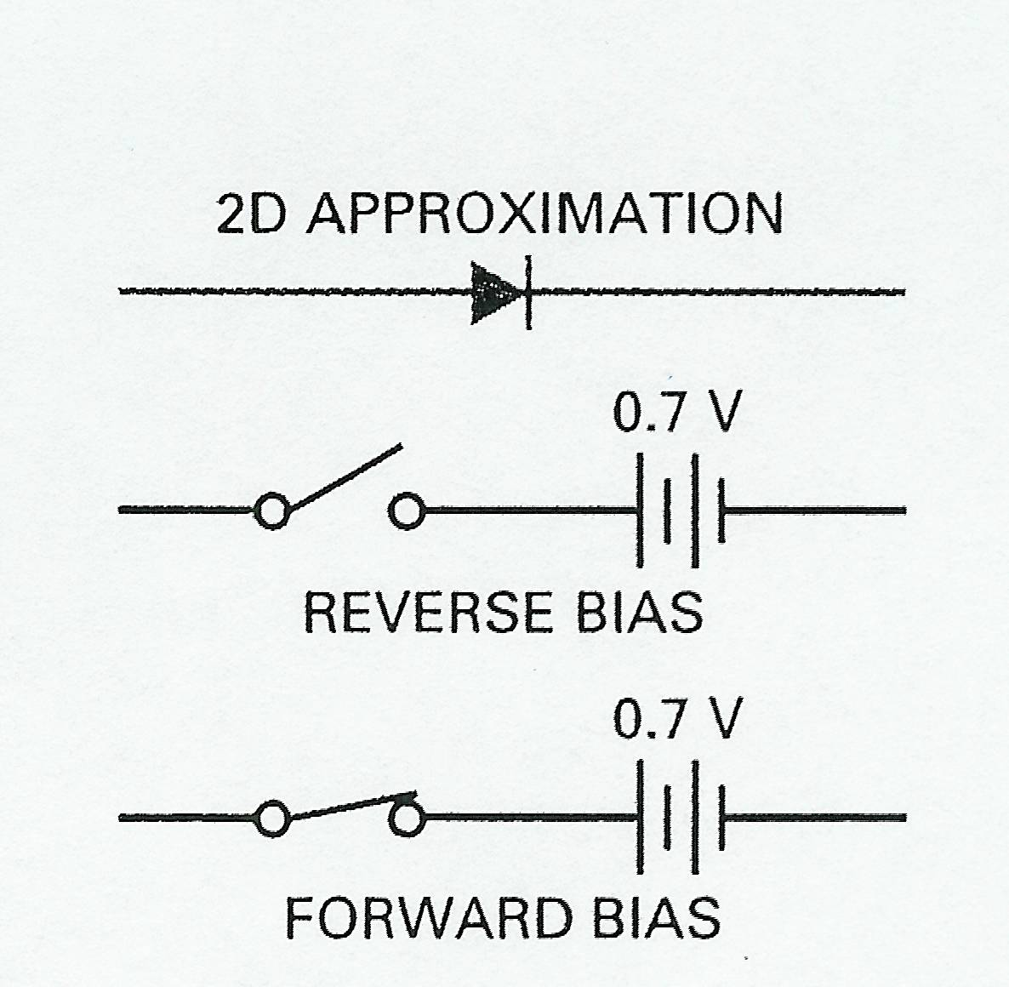
Second approximation

Slide 16
Diode third approximation
This model assumes that no diode current flows until the forward bias across the diode reaches 0.7 volts.
This model ignores the exact shape of the knee.
This model does account for the diode’s bulk resistance.
However, bulk resistance that is less than 1 Ω
can be ignored.

Slide 17
Third approximation
0.7 V
R_{B}
Reverse bias
0.7 V
R_{B}
Forward bias

Slide 18
Appropriate approximation
The first approximation is adequate for most troubleshooting situations.
The second approximation is often used if more accurate values for load current and voltage are required.
The third approximation improves accuracy when the diode’s bulk resistance is more than 1/100 of the Thevenin resistance facing the diode.

Slide 19
Silicon diode testing using an ohmmeter
Low resistance in both directions: the diode is shorted.
High resistance in both directions: the diode is open.
Relatively low resistance in the reverse direction: the diode is leaky.
If the ratio of reverse to forward resistance is > 1000: the diode is good.

Slide 20
Silicon diode testing using a DMM
Set DMM to diode test function
A connected forward-biased diode will display the pn-junction’s forward voltage (~0.5V to 0.7V)
When the diode is reversed-biased by the test leads, meter displays over-range indication such as “OL” or “1”

Slide 21
Silicon diode testing using a DMM
(continued)
A shorted diode displays a voltage less than 0.5V in both directions
An open diode would be indicated by an over-range display in both directions
A leaky diode would display a voltage less than 2.0V in both directions

Slide 22
Data sheets
Useful to circuit designers
Useful to repair technicians
Typical entries include:
Breakdown voltage
Maximum forward current
Forward voltage drop

Slide 23
Bulk resistance calculation
200
.
175
0.875 V - 0.75 V
150
R_{B} =
175 mA - 75 mA
125
= 1.25 Ω
100
Forward current in mA
.
75
50
25
0
0
0.5
1.0
1.5
Forward bias in volts

Slide 24
DC resistance
200
.
0.875 V
175
R_{F} =
175 mA
150
= 5 Ω
125
100
Forward current in mA
.
0.75 V
75
R_{F} =
75 mA
50
= 10 Ω
25
0
0
0.5
1.0
1.5
Forward bias in volts
The forward resistance decreases as current increases.

Slide 25
Silicon diode resistance values
The reverse resistance is very high: typically tens or hundreds of megohms.
The forward resistance is not the same as the bulk resistance.
The forward resistance is always greater than the bulk resistance.
The forward resistance is equal to the bulk resistance plus the effect of the barrier potential.

Slide 26
R_{S} = 10 Ω
V_{S} = 1.5 V
A circuit like this can be solved in several ways:
1. Use the first (ideal) approximation.
2. Use the second approximation.
3. Use the third approximation.
4. Use a circuit simulator.
5. Use the diode’s characteristic curve.

Slide 27
R_{S} = 10 Ω
V_{S} = 1.5 V
Using the characteristic curve is a graphical solution:
1. Find the saturation current using Ohm’s law.
2. The cutoff voltage is equal to the supply voltage.
3. Locate these two points on the diode’s curve.
4. Connect them with a load line.
5. The intersection is the graphical solution.

Slide 28
Graphical Solution
200
175
10 Ω
150
1.5 V
125
Load line
100
Q
Forward current in mA
.
75
1.5 V
I_{SAT} =
= 150 mA
10 Ω
50
V_{CUTOFF} = 1.5 V
25
0
0
0.5
1.0
1.5
Source voltage in volts
Q is the operating point

